Slide 1

Old Testament Survey:
Literature
Deuteronomy
Dr. Keith Evan Schubert

Slide 2
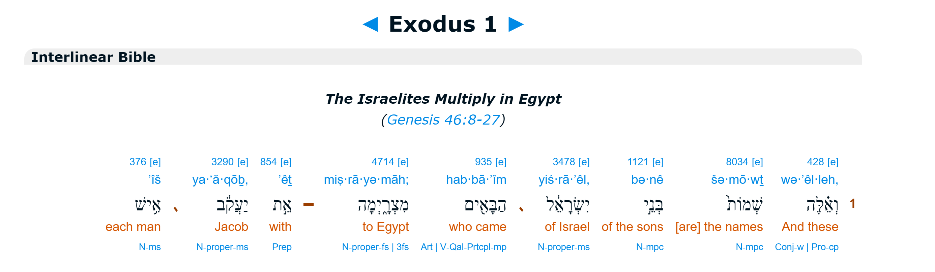
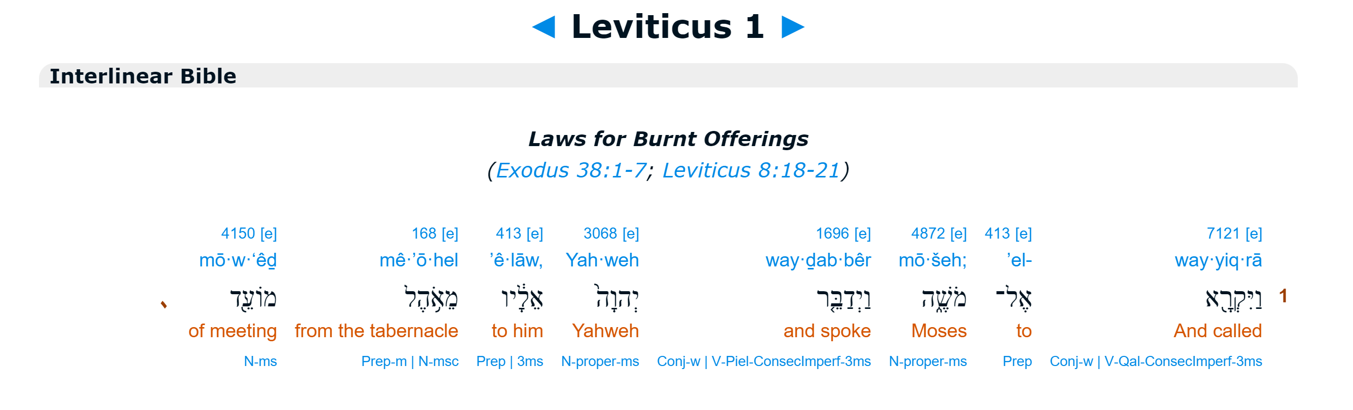
First Words

Slide 3
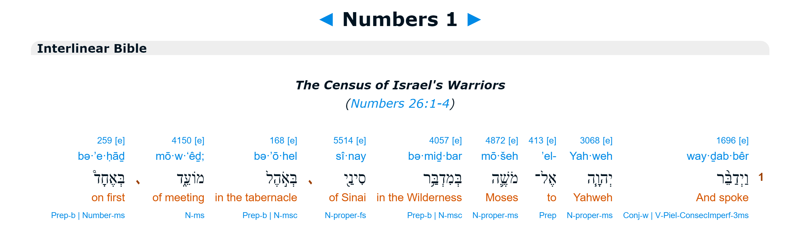
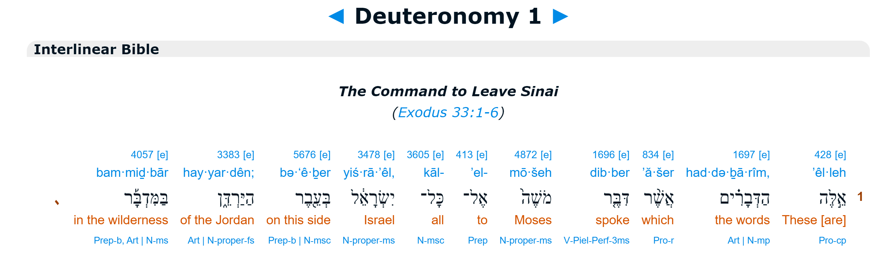
First Words

Slide 4
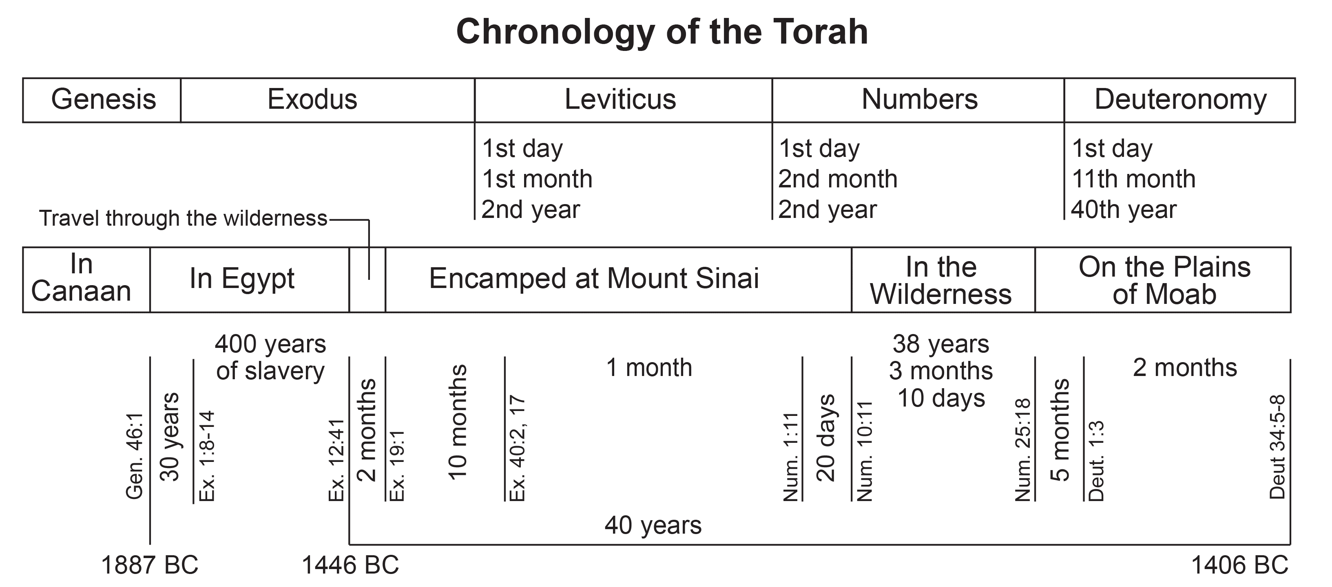

Slide 5
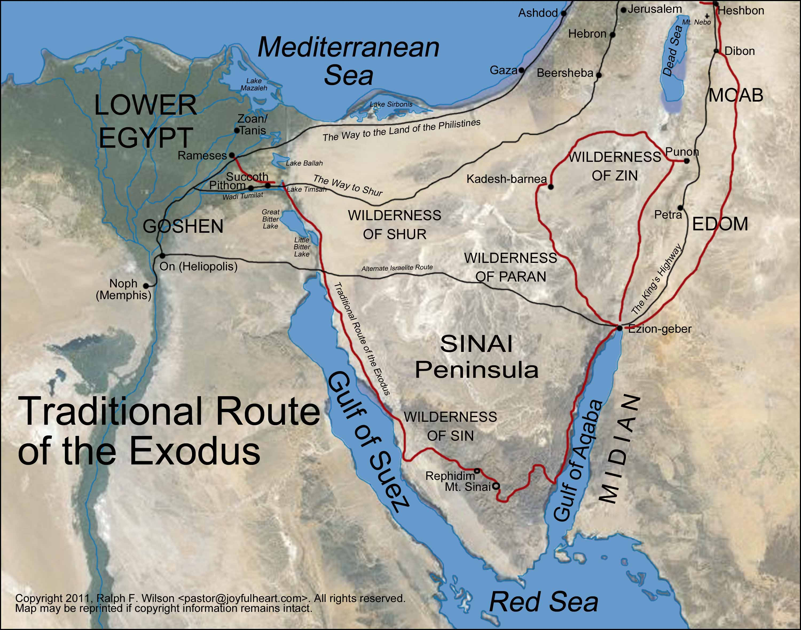

Slide 6
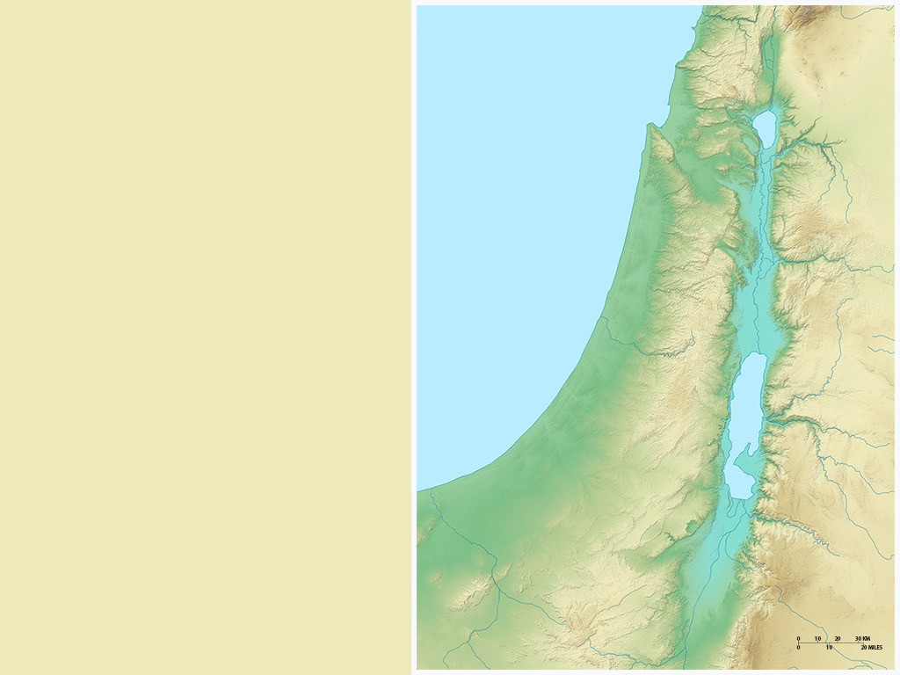
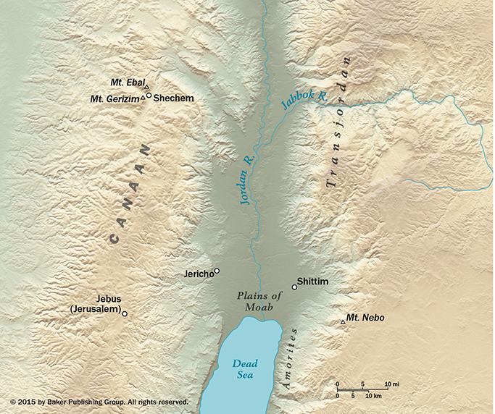
Bashan
Yarmuk
Dome of
Gilead
Jabbok
Ammon
Wilderness of Paran
Mishor
Wilderness of Paran
Arnon
Moab
Zered
EDOM

Slide 7
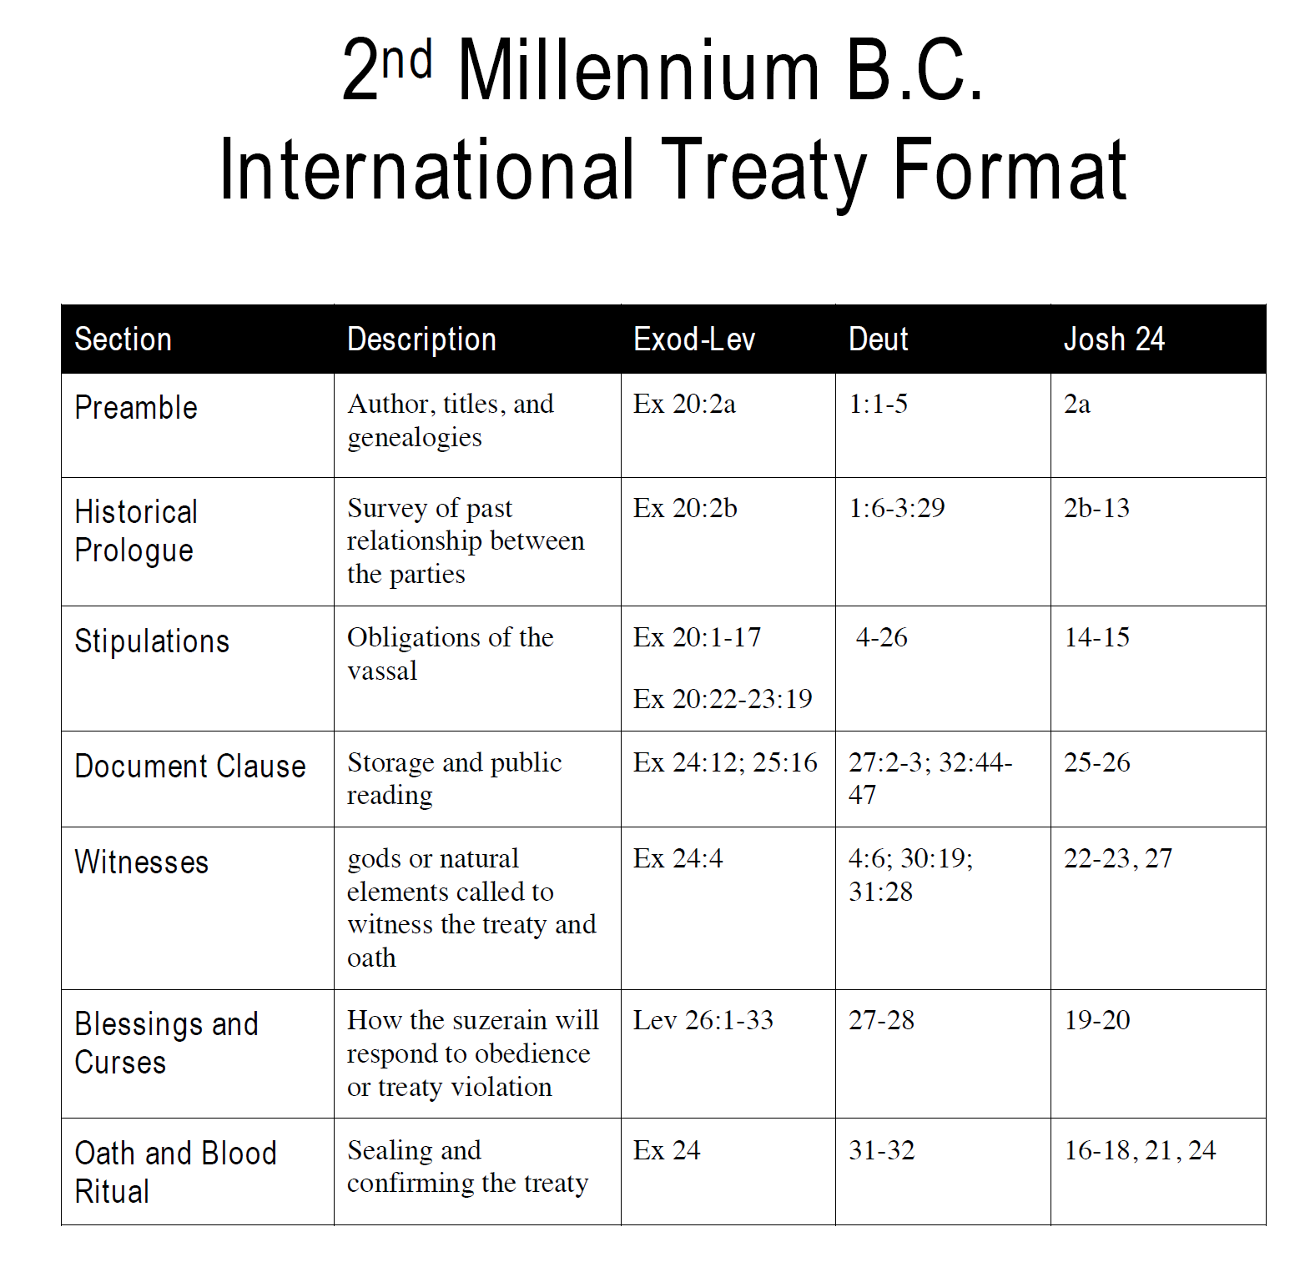
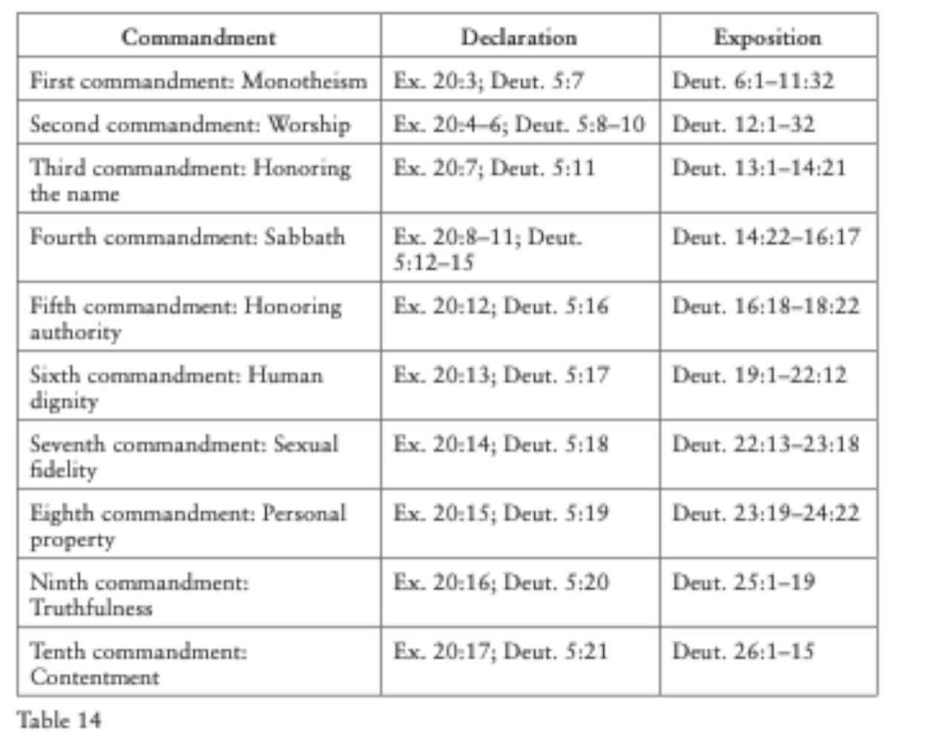
Deuteronomy

Slide 8
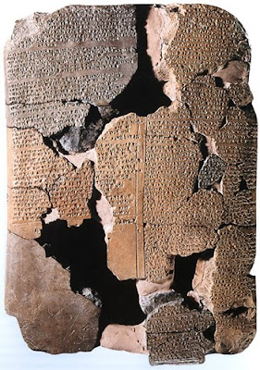
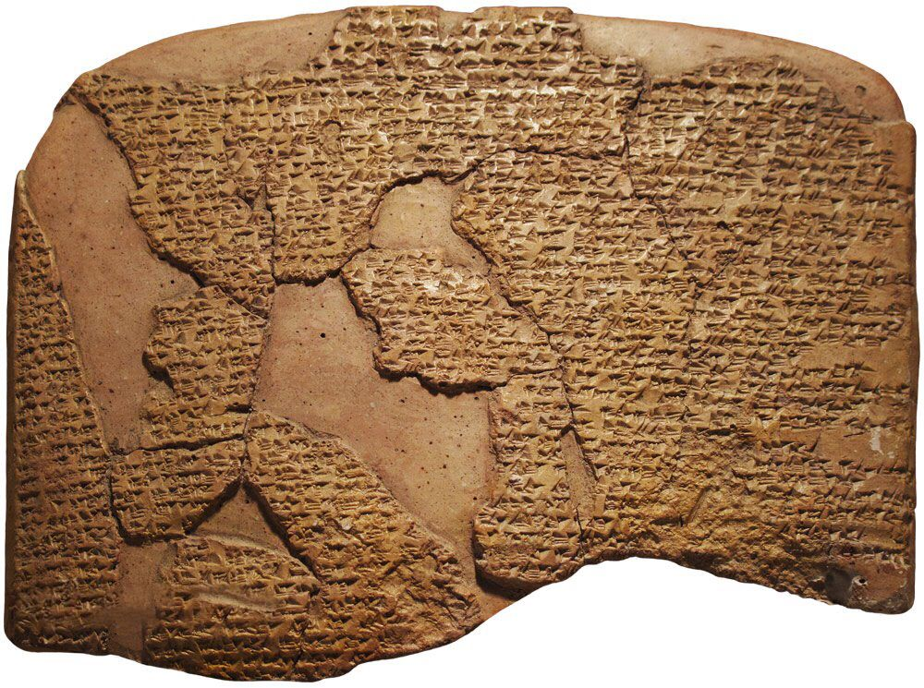
Hittite Treaty (2nd Millenium BC)

