Slide 1

Old Testament Survey:
Literature
Joshua & Judges
Dr. Keith Evan Schubert

Slide 2
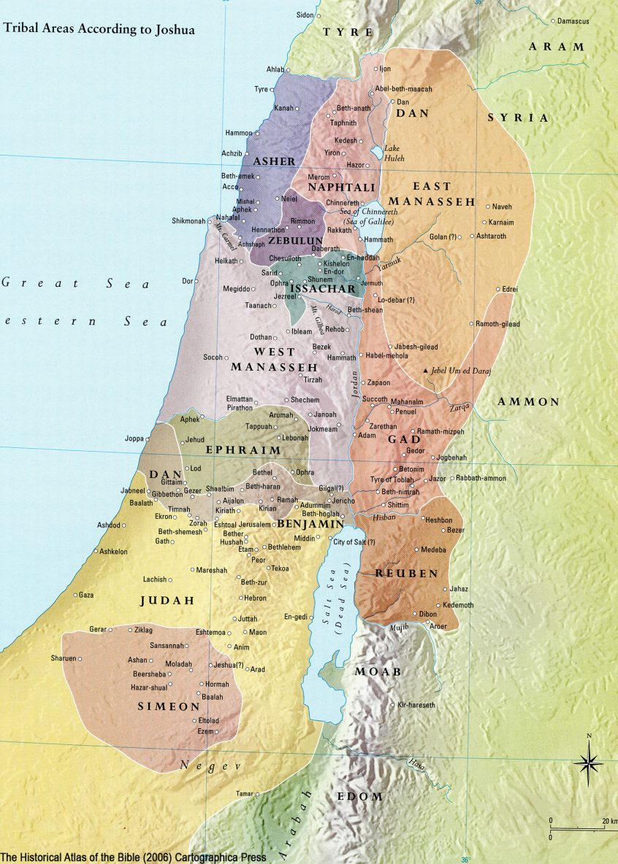
Joshua
Military History & Narrative (prose epic)
  1-5 Preparations
    Enter their situation
  6-12 Conquests
    Holy War
Documentary History & Expository
  13-21 Divisions
    maps
Narrative & Oration
  22-24 Renewal
    Bring to our time

Slide 3
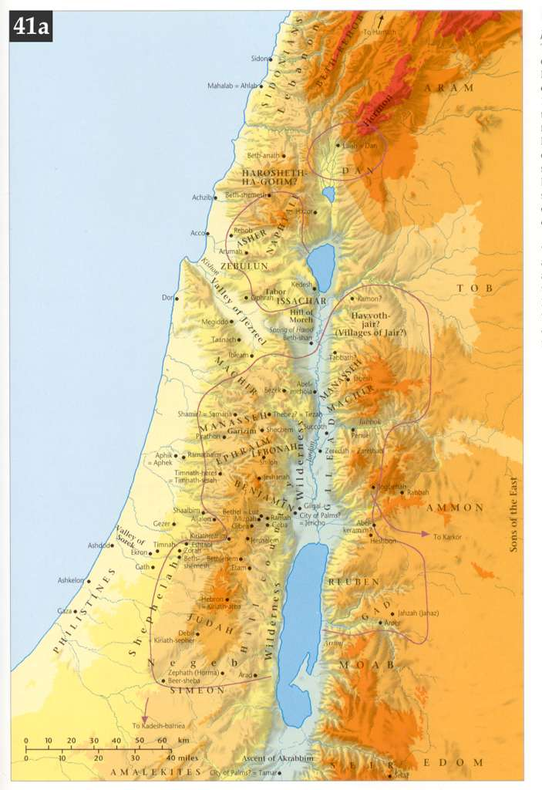
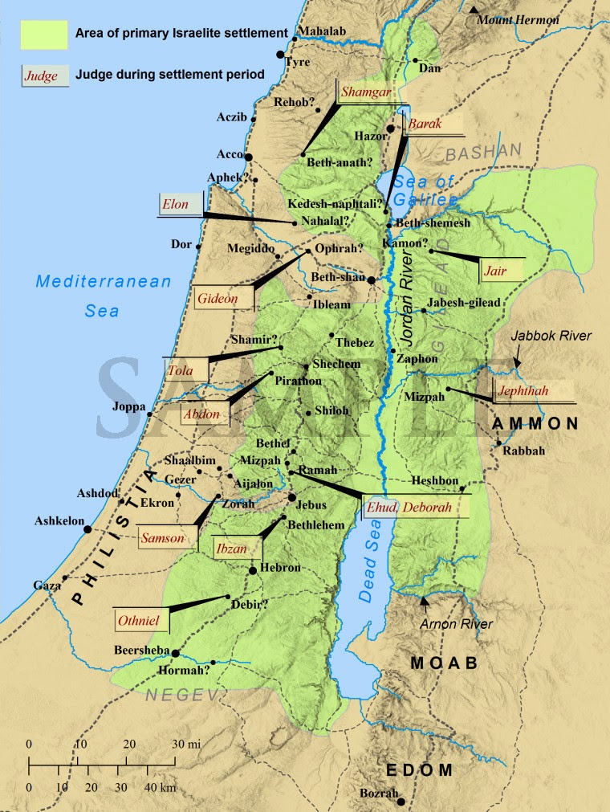
Judges
Leontes
Kishon
Yarmuk
Yarkon
Kanah
Sorek
Besor
Zered

