Slide 1

Old Testament Survey:
Literature
Ruth
Dr. Keith Evan Schubert

Slide 2
Session 2
Week Book(s)
_____ _______________________________________________
Ruth
Samuel, Kings, Chronicles (founding, Omri & Jehu)
Job
Proverbs
Psalms
Major Prophets (Ezekiel, possibly more)
Minor Prophets (leaning towards Haggai & Zechariah)

Slide 3
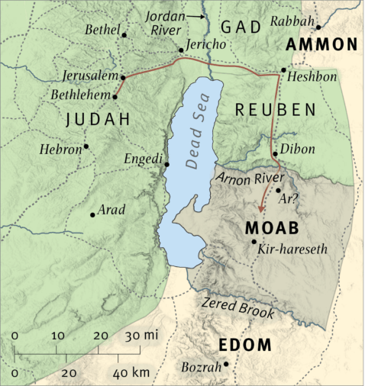
Name | Meaning
Bethlehem | House of bread
Elimelech | God is my king
Naomi (Mara) | Pleasant (Bitterness)
Mahlon | Sickly
Chilion | Wasting
Ruth | Friendship
Orpah | Fawn
Boaz | Quickness or In His Strength (debated)
Obed | Worshipper
Jesse | God’s Gift
David | Beloved

