Slide 1

Old Testament Survey:
Literature
Job
Dr. Keith Evan Schubert

Slide 2
Week Book(s)
_____ _______________________________________________
Ruth
Samuel, Kings, Chronicles (founding, Omri & Jehu)
Job
Proverbs
Psalms
Major Prophets (Ezekiel, possibly more)
Minor Prophets (leaning towards Haggai & Zechariah)

Slide 3
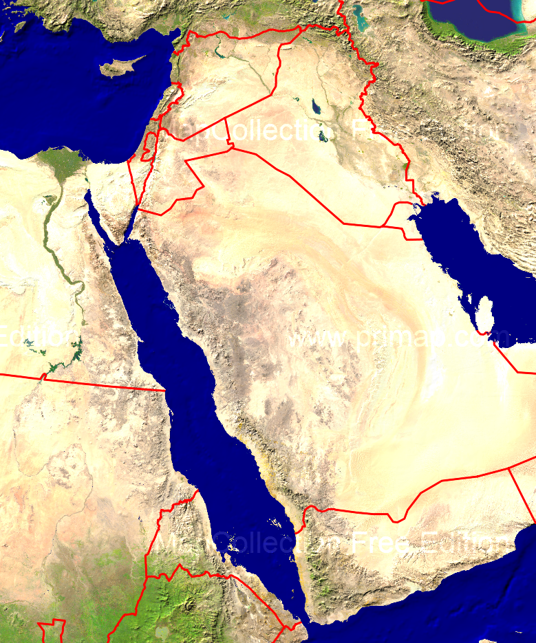
Name meanings
Job – enemy/hated
  If a shortened form of Jobab then to cry/howl out or a desert
Eliphaz – God is (pure) gold (4-5, 15, 22)
Bildad – confusing love (8, 18, 25)
Zophar – Chirping/early riser (11, 20)
Elihu – my God is he (32-37)
Uz
Chaldea
Uz – Council/advice (Aram or Edom)
  Connected to Aram
    firstborn son of Aram son of Shem in Genesis 10:23, Genesis 22:21 and 1 Chronicles 1:42
    Jeremiah 25 lists Uz and Edom but not Aram
  connected to Edom in
    Lamentations 4:21,
    Jeremiah 25:20-21
    Possibly Job is Jobab, king of Edom and grandson of Esau in Genesis 36:33
Teman – City in Edom connected with wisdom
Shuhite – descendant of Shuah son of Abraham and Keturah
Naamah – common place name meaning pleasant
Sheba

Slide 4
When was Job written?
Why Patriarchy period?
  Wealth in livestock
  Acted as priest for family
  Lifespan like patriarchs
  Description of death is similar to Abraham
  Some of the locations and people appear in Abraham’s geneology
Uz-> Edom or Aram
  East is usually connected with east of Jordan (Ammon, Moab, Edom)
Many parallel versions in ancient world
  A man and his god (2k BC, suffering, petition god, repentance brings healing)
  Babylonian Theodicea (1k BC, discussion in chiasm between man and friend discussing why good suffer and evil prosper)
  Babylonian Job (1300BC, wealthy pious man reduced to suffering, no answer, eventually restored, praises Marduk)
  Many others

Slide 5
Ordering of Job
Prologue (Narrative) 1-2
Job's lament (Poetry) 3
Speeches of the friends and Job’s responses (Poetry)
  Eliphaz 4-5 ⇒ Job 6-7
  Bildad 8 ⇒ Job 9-10
  Zophar 11 ⇒ Job 12-14
  Eliphaz 15 ⇒ Job 16-17
  Bildad 18 ⇒ Job 19
  Zophar 20 ⇒ Job 21
  Eliphaz 22 ⇒ Job 23-24
  Bildad 25 ⇒ Job 26-27, 29-31
Wisdom poem (Poetry) 28
F. Elihu speeches (Poetry) 32-37
G. God's speeches and Job's response (Poetry) 38-42:6
H. Epilogue (Narrative) 42:7-17

