Slide 1

Old Testament Survey:
Literature
Proverbs
Dr. Keith Evan Schubert

Slide 2
Week Book(s)
_____ _______________________________________________
Ruth
Samuel, Kings, Chronicles (founding, Omri & Jehu)
Job
Proverbs
Psalms
Major Prophets (Ezekiel, possibly more)
Minor Prophets (leaning towards Haggai & Zechariah)

Slide 3
Background
I Kings 3 – Prayer for wisdom
Proverbs are not promises
Proverbs express how things normally work (Pr 13:25)
Proverbs express extremes such as polar opposites (Pr 13:4)
Proverbs apply to particular situations (Pr 26:4-5)
THE GOSPEL PROMISED BEFOREHAND

Slide 4
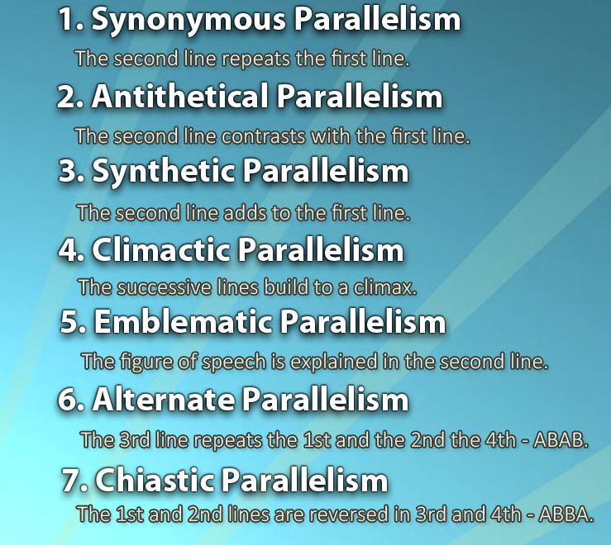

Parallelism
Synonymous
  Proverbs 16:18, 18:15
Antithetical
  Proverbs 15:1, 17:22
Synthetic
  Proverbs 16:12
Climactic
  Isaiah 1:8
Emblematic
  Isaiah 1:18
Alternate
  Isaiah 1:18
Chiastic
  Proverbs 31:10-31
Composite
  Psalms 1:1

Slide 5
STRUCTURE AND CONTENTS
Introduction 1:1-7
Call to wisdom
  "my son“ (ben/benim – Hebrew) wisdom poems 1:8-9:18
  Wisdom’s call ch. 8
  Calls of wisdom and folly ch. 9
Proverbs of Solomon 10:1-22:16
Words of the wise 22:17-24:22
More words of the wise 24:23-24
Proverbs of Solomon (Hezekiah) 25-29
Words of Agur 30
Words of king Lemuel (son here is bar - aramaic) 31
  1:8
  1:10
  1:15-
  2:1
  3:1
  3:11
  3:21
  4:1 (p)
  4:10
  4:20
  5:1
  5:7 (p)
  5:20-
  6:1
  6:3-
  6:20
  7:1
  7:24 (p)
  8:32 (p)

Slide 6
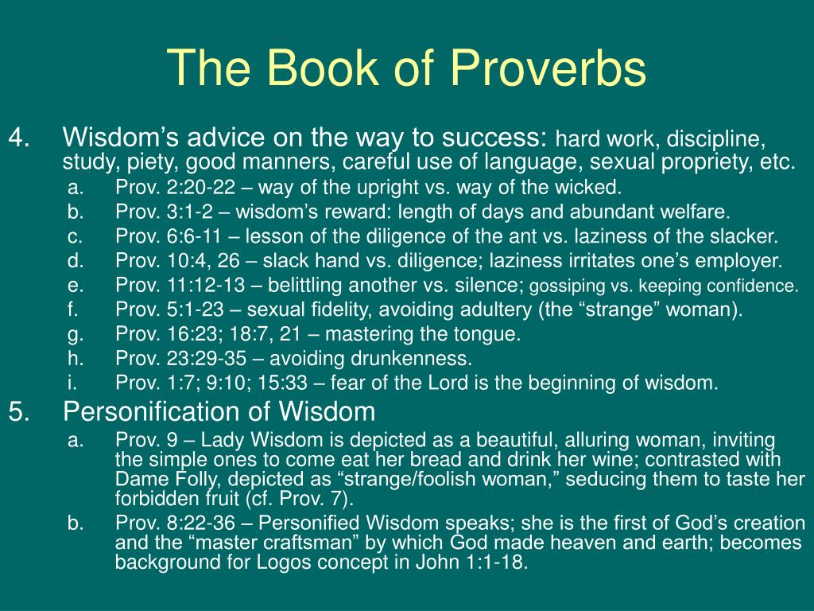

Slide 7
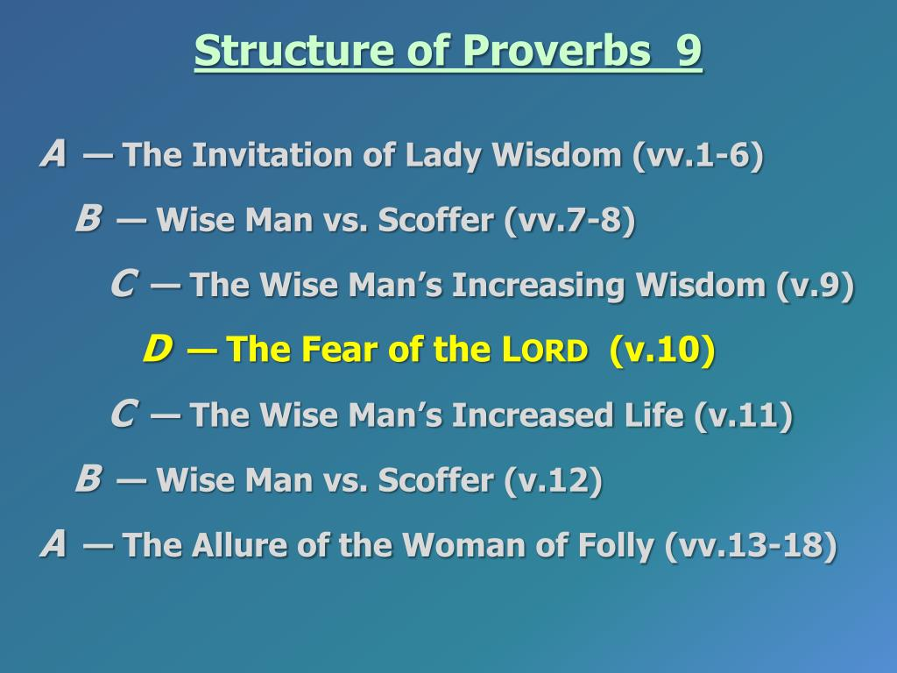

Slide 8
Proverbs 31:10-31
acrostic
High value of good wife (v10)
  Husband benefitted (v. 11-12)
    works hard (v. 13-19)
      Gives to poor (v. 20)
        No fear of snow (v. 21a)
          Children in scarlet (v. 21b)
            Coverings for bed, wearing linen (v. 22)
              Husband publicly respected (v. 23)
            Sells garments and sashes (v. 24)
          Clothed with dignity (v.25a)
        No fear of future (v.25b)
      Speaks Wisdom (v.26)
    works hard (v. 27)
  Husband & children paise (v. 28-29)
High value of good wife (v30-31)

Slide 9
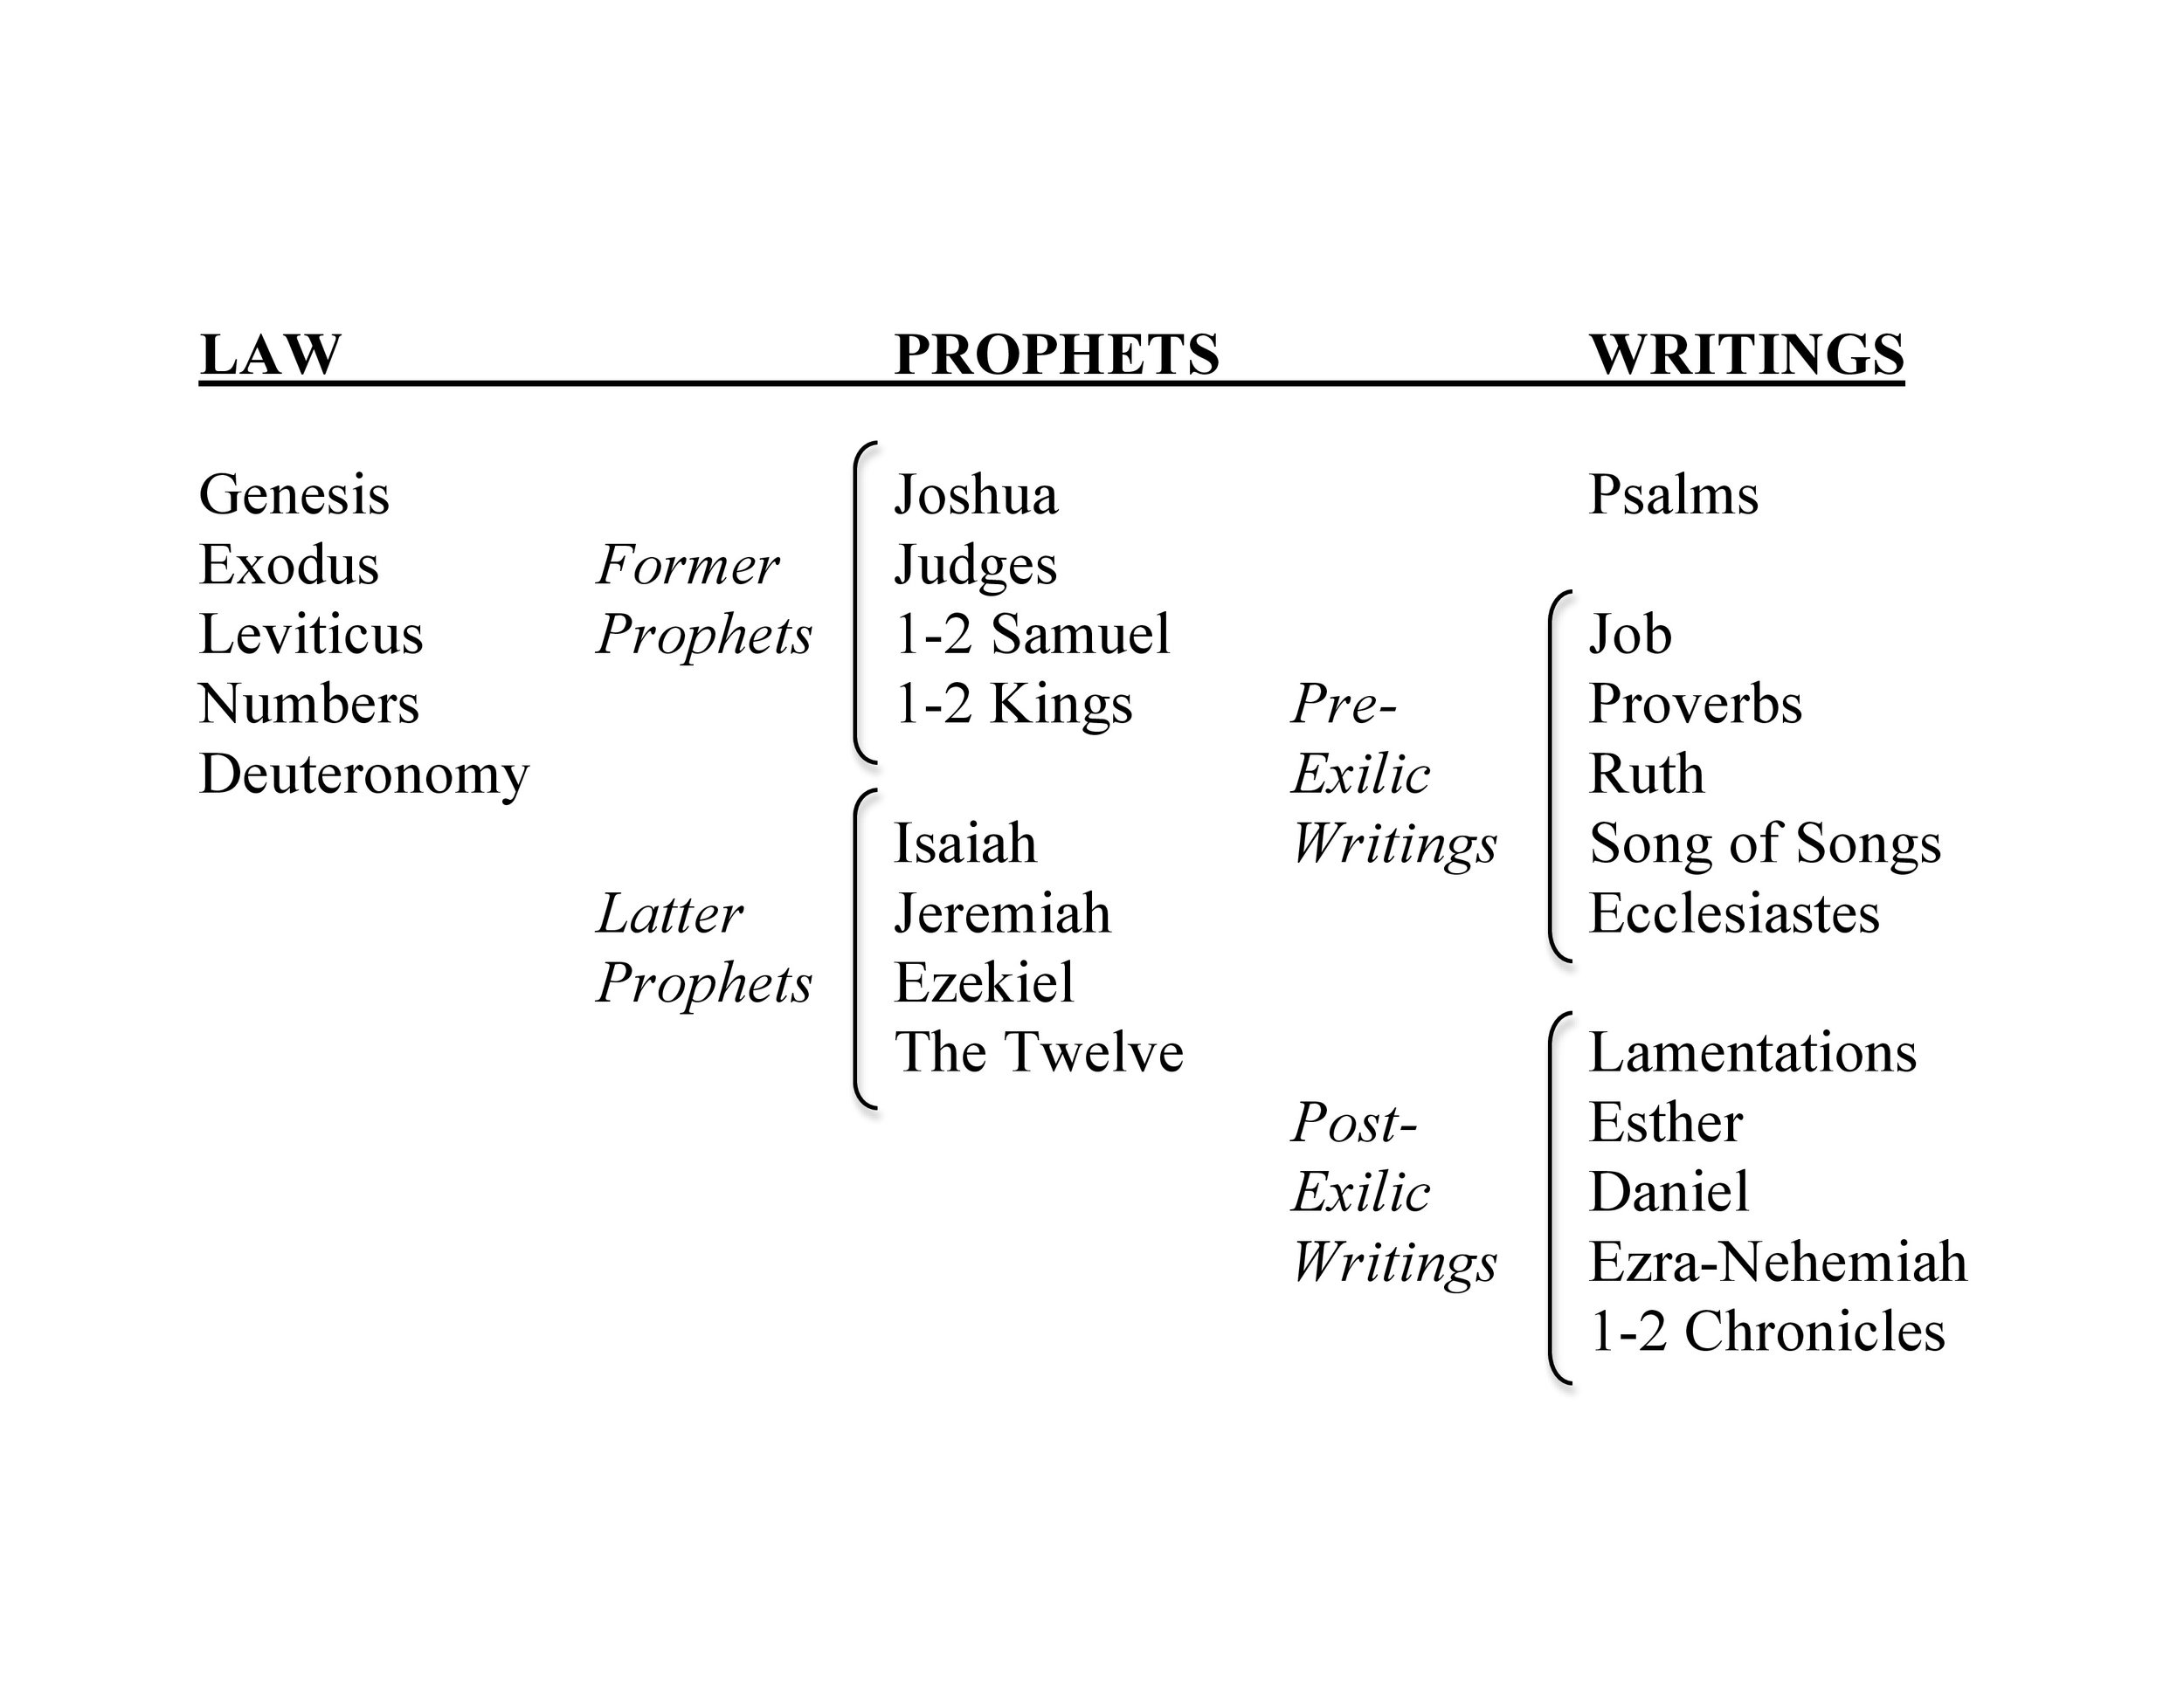
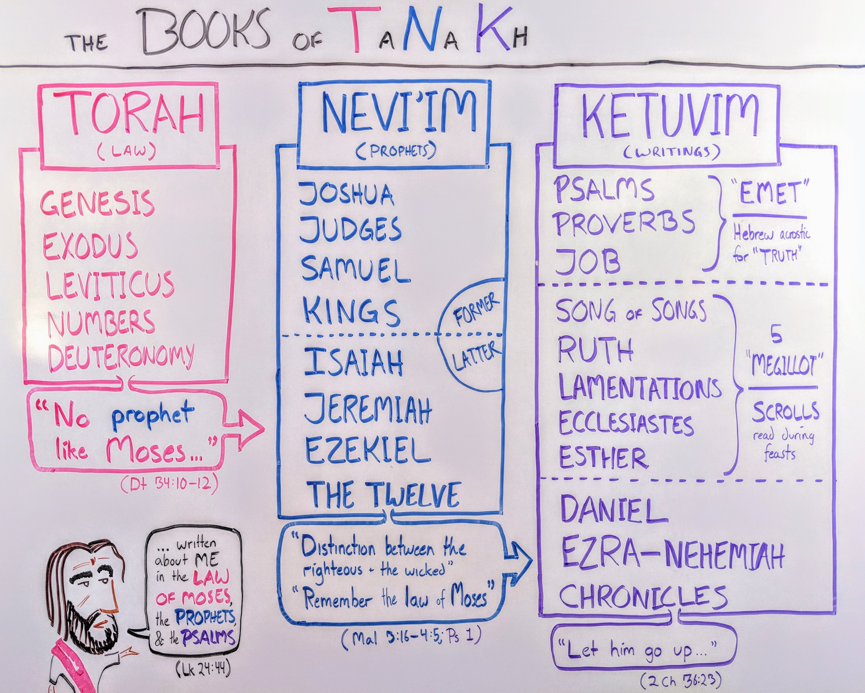
TNK order (ancient and modern)

