Slide 1

Old Testament Survey:
Literature
Minor Prophets
Dr. Keith Evan Schubert

Slide 2
Week Book(s)
_____ _______________________________________________
Ruth
Samuel, Kings, Chronicles (founding, Omri & Jehu)
Job
Proverbs
Psalms
Major Prophets (Ezekiel, possibly more)
Minor Prophets (leaning towards Haggai & Zechariah)

Slide 3
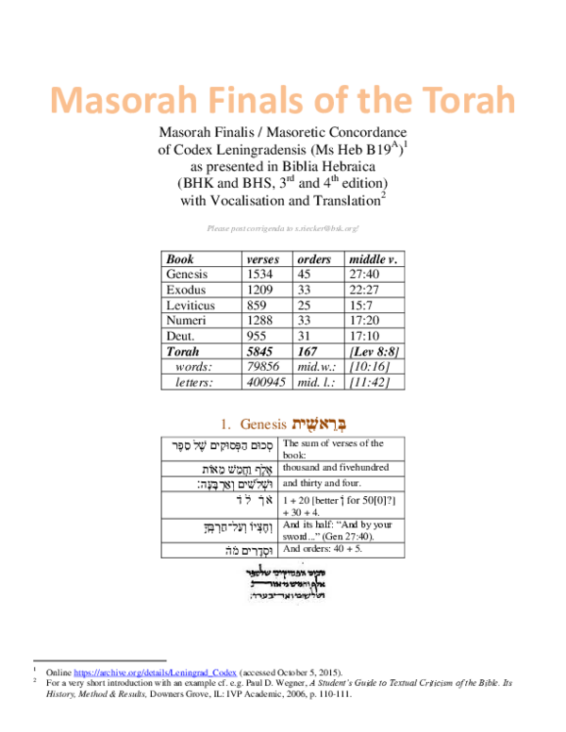
Why one book?
Always on the same scroll
End of books had a Masorah Finalis
  Number of verses/words/letters
  Middle verses/words/letters
  For minor prophets, only one Masorah Finalis
When scribes finished a book they left 4 blank lines before beginning the next book, but only 3 lines between the minor prophets
Tradition

Slide 4
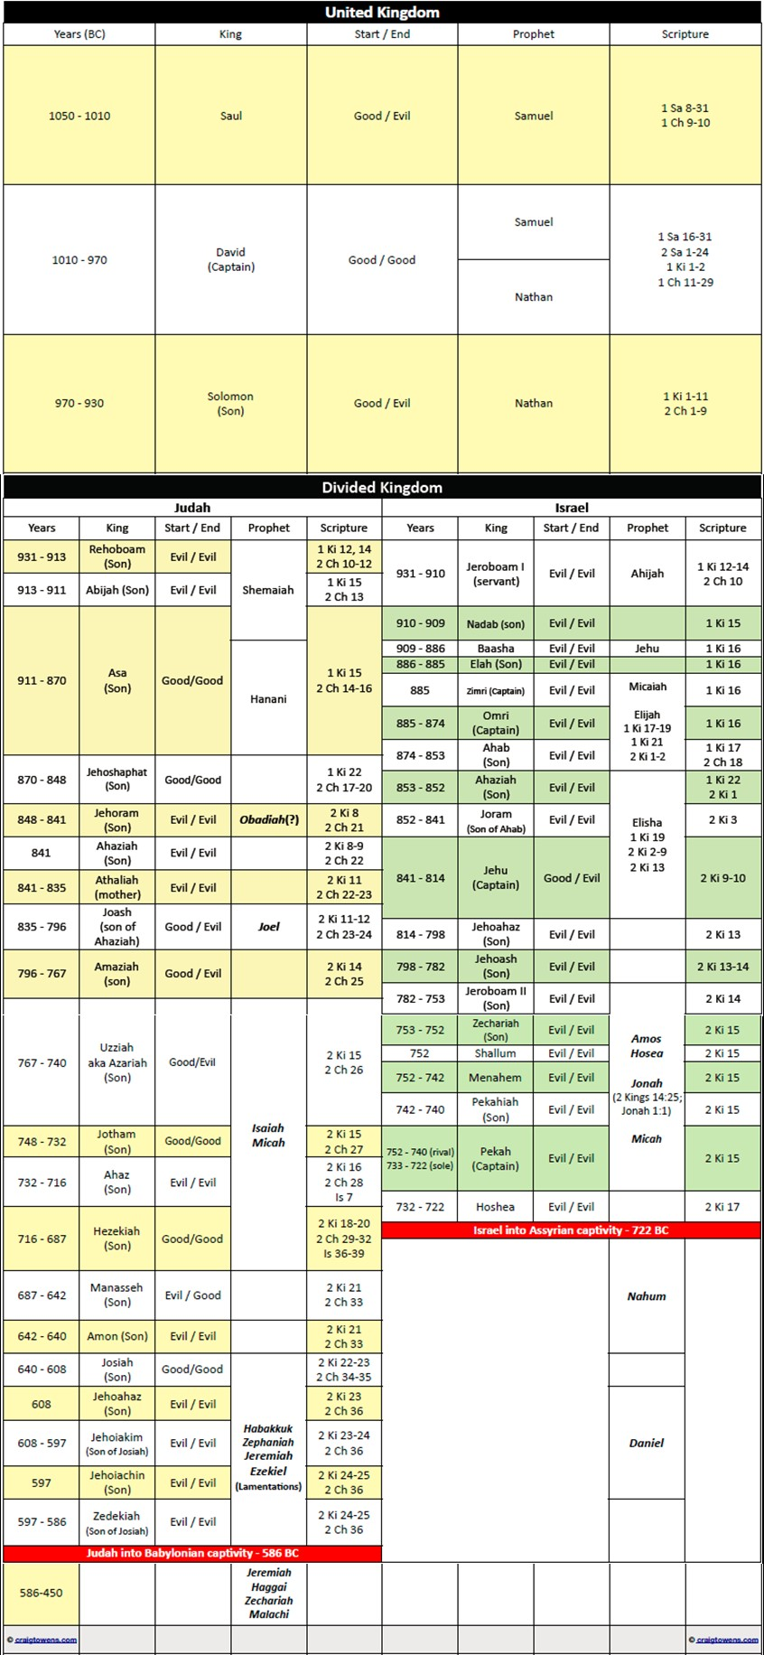

Slide 5
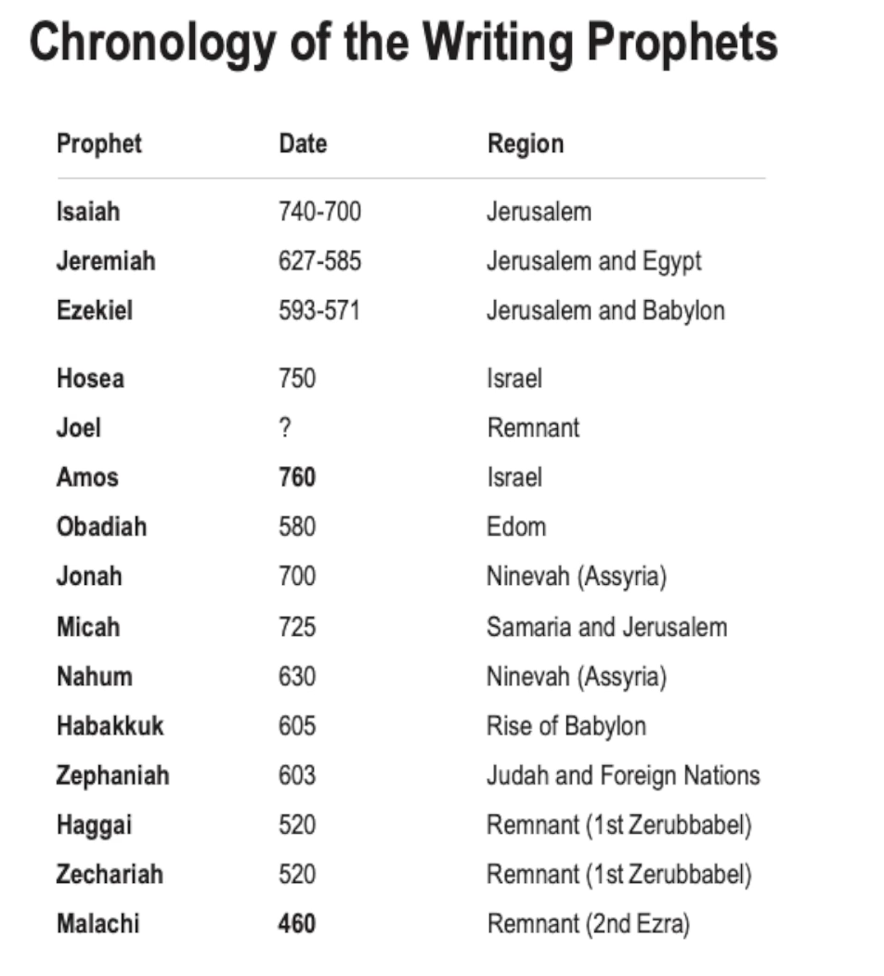
The Twelve
HOSEA “Salvation” – vs Israel’s adultery/idolatry, ~60 yr ministry
JOEL “Yahweh is God” – the day of the Lord, locust plague, future blessings
AMOS “Burden” – (Tekoa) vs sins in North, reunite with south under Davidic king
OBADIAH “Servant of Yahweh” – vs Edom, submission to Israel at Zion on Day of Lord
JONAH “Dove” – vs Ninevah, flee on boat, swallowed, preach repentance, Ninevah repents, Jonah is mad
MICAH “Who is like Yahweh?” – (Moresheth-Gath) Assyria then Babylon will be used to punish Israel and Judah
NAHUM “Comforter” – Downfall of Ninevah for destroying Israel
HABAKKUK “embrace/wrestle” – reassurance of God’s justice in use the punishment of Babylon
ZEPHANIAH “Yahweh hides” – Purge of Jerusalem on Day of the Lord, ends in restoration
HAGGAI “festive” – rebuild the temple, greater return to come
ZECHARIAH “Yahweh remembers” – temple will be one to which nations come, return to me and I will return to you
MALACHI “messenger” – Return to Yahweh, rejection of divorce, 6 oracles with 10 questions

Slide 6
Haggai
1:1-16 Call to build temple and response
2:1-9 Encouragement by God’s presence and future temple glory
2:10-19 Defilement and blessing
2:20-23 Lord takes Zerubbabel

Slide 7
Zechariah
Ch 1-6: 8 apocalyptic visions
  Look/see/showed
  1:8 Man on Red horse among Myrtle Trees
  1:18 Four Horns and Four Craftsmen
  2:1 Man With a Measuring Line
  3:1 Clean Garments for the High Priest
  4:1 Gold Lampstand and two Olive Trees
  5:1 Flying Scroll
  5:5 Woman in a Basket
  6:1Four Chariots
Ch 7-8: 4 prophetic messages
  The Word of the Lord
  7:1 mourning and fasting
  7:8 justice, mercy, compassion
  8:1 bless Zion
  8:18 fasts to joy, love truth and peace
Ch 9-14: 2 oracles
  The oracles/burden of the word of the Lord
  9:1 vs Damascus, coming of king, care for Israel, 2 Shepherds
  12:1 vs. Jerusalem’s enemies, cleans from sin, strike shepherd, Lord comes to reign

Slide 8
Malachi
1:1 Intro
1:2-5 Yahweh's love
1:6-2:9 Priests unfaithful
2:10-16 Divorce
2:17-3:5 Impugning God
3:6-12 Tithe
3:13-14 Faithful
4:1-6 Judgement and renewal

Slide 9
